Slide 1
BT 205: Cell & Molecular Biology
-Prof. Siddhartha Sankar Ghosh

Slide 2
Syllabus:
Transcription
Eukaryotic RNA splicing and processing
Translation; regulation of gene expression
Cell signaling
Oncogenes, Programmed cell death
Genes in differentiation and development

Slide 3
Transcription

Slide 4
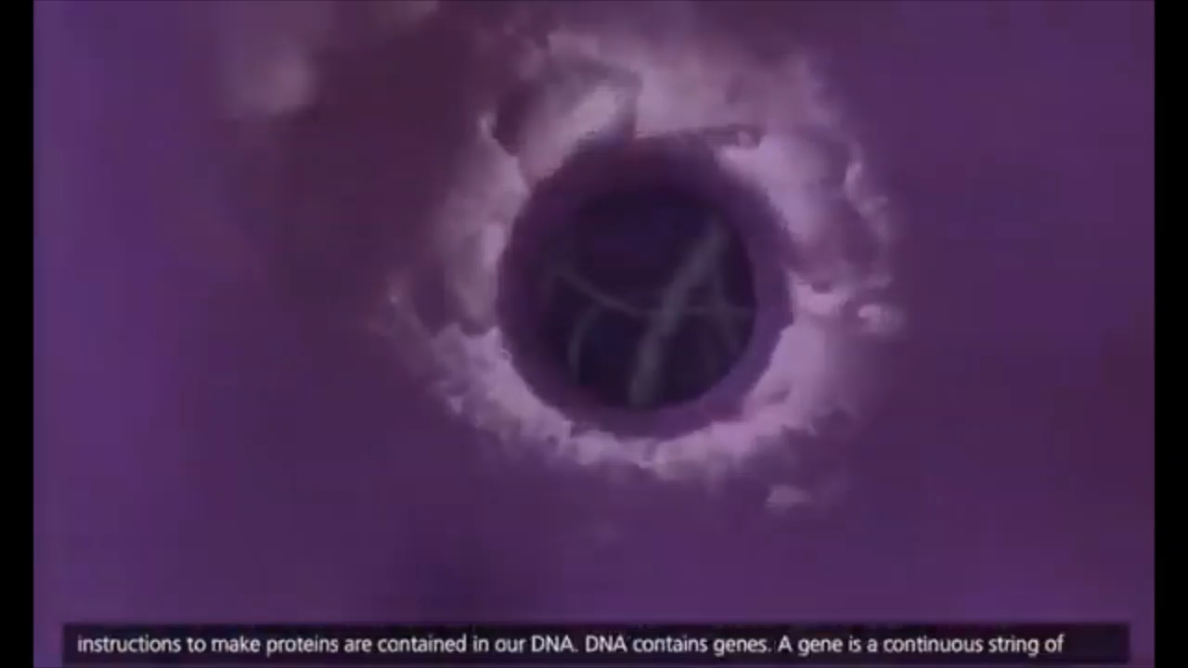

Slide 5
The first step in expression of a gene, the transcription of DNA into RNA, is the initial level at which gene expression is regulated in both prokaryotic and eukaryotic cells.
RNAs in eukaryotic cells are then modified in various ways-for example, introns are removed by splicing-to convert the primary transcript into its functional form.
Different types of RNA play distinct roles in cells: Messenger RNAs (mRNAs) serve as templates for protein synthesis; ribosomal RNAs (rRNAs) and transfer RNAs (tRNAs) function in mRNA translation.
Still other small RNAs function in gene regulation, mRNA splicing, rRNA processing, and protein sorting in eukaryotes.
In fact, some of the most exciting advances in recent years have pertained to the roles of noncoding RNAs (microRNAs) as regulators of both transcription and translation in eukaryotic cells.

Slide 6
E. coli RNA polymerase
The complete enzyme consists of six subunits: two α, one β, one β’: one ω and one σ. The σ subunit is relatively weakly bound and can be dissociated from the other five subunits, which constitute the core polymerase.

Slide 7
Sequences of E. coli promoter
E. coli promoters are characterized by two sets of sequences located 10 and 35 base pairs upstream of the transcription start site ( + 1 ). The consensus sequences shown correspond to the bases most frequently found in different promoters.

Slide 8
DNA foot printing

Slide 9
DNA foot printing
A sample containing fragments of DNA radiolabeled at one end is divided in two.
One half of the sample is incubated with a protein that binds to a specific DNA sequence within the fragment.
Both samples are then digested with DNase, under conditions such that the DNase introduces an average of one cut per molecule.
The region of DNA bound to the protein is protected from DNase digestion. The DNA-protein
complexes are then denatured, and the sizes of the radiolabeled DNA fragments produced by DNase digestion are analyzed by electrophoresis.
Fragments of DNA resulting from DNase cleavage within the region protected by protein binding are missing from the sample of DNA that was incubated with protein.

Slide 10
Transcription by E- coli RNA polymerase

Slide 11
THANK YOU

